Slide 1
Next Steps

Slide 2

NetAcad
https://www.cisco.com/c/m/en_sg/partners/cisco-networking-academy/index.html

Slide 3





College

Slide 4
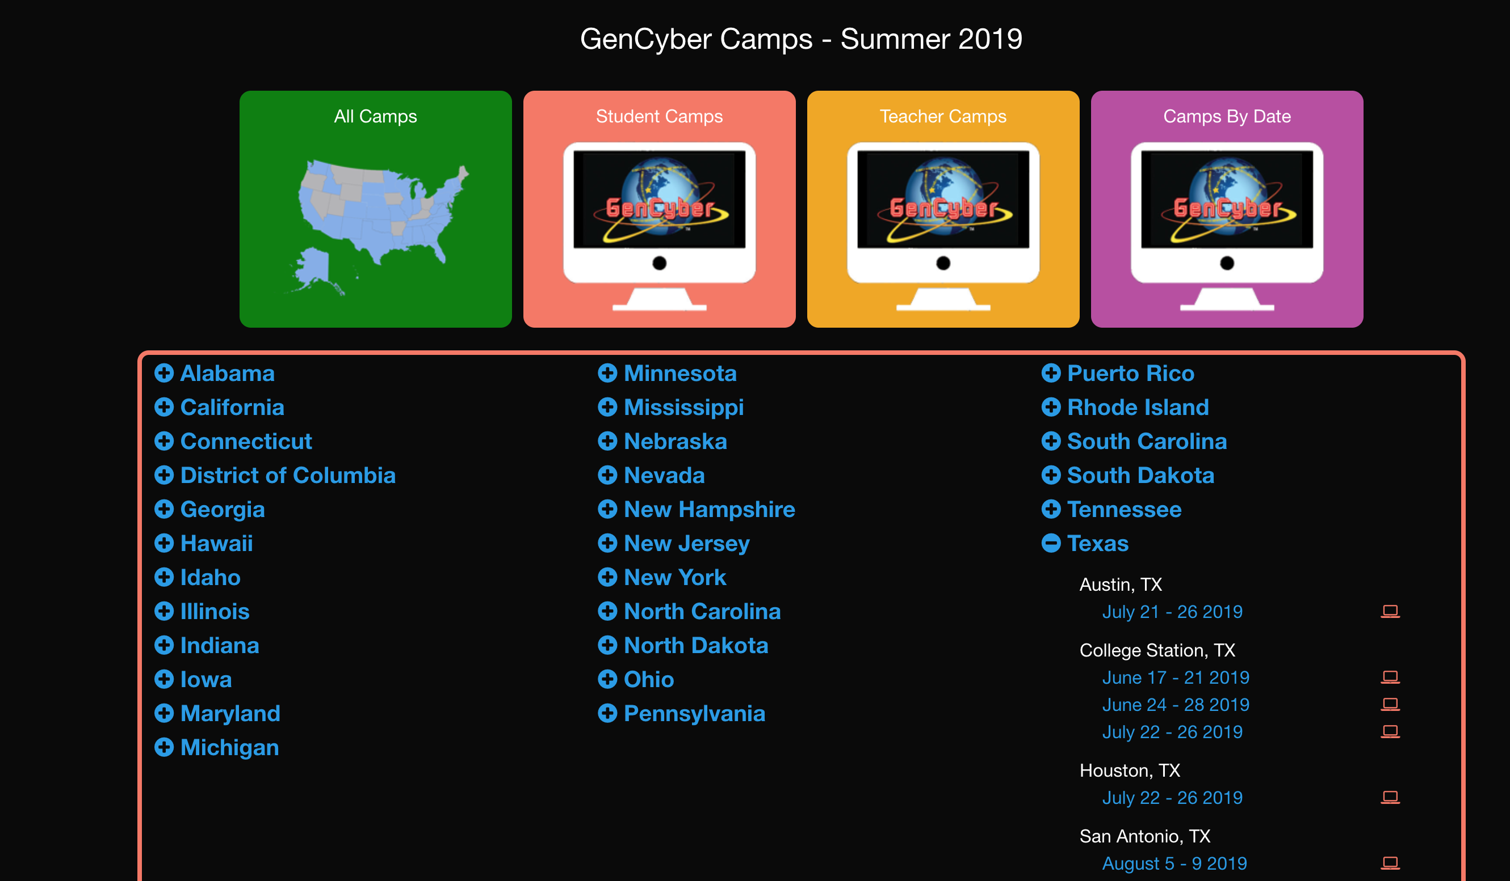
Other camps

Slide 5

Scholarships

Slide 6

Certifications

Slide 7
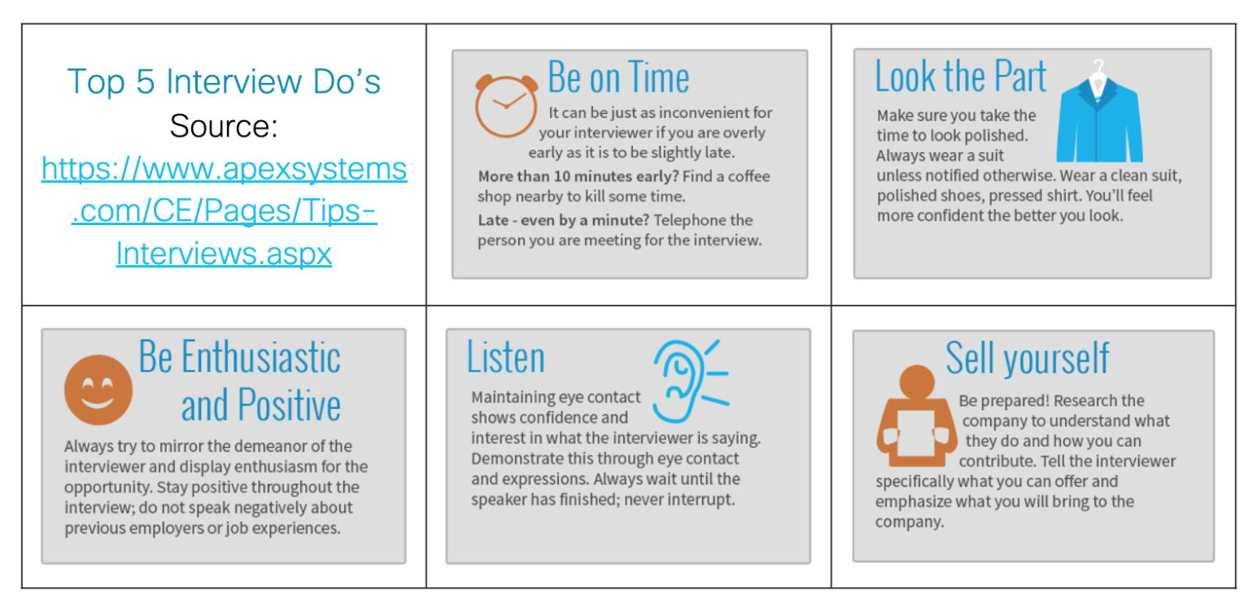
Interviews and Employers

Slide 9
https://github.com/txjenniek/

